Slide 1
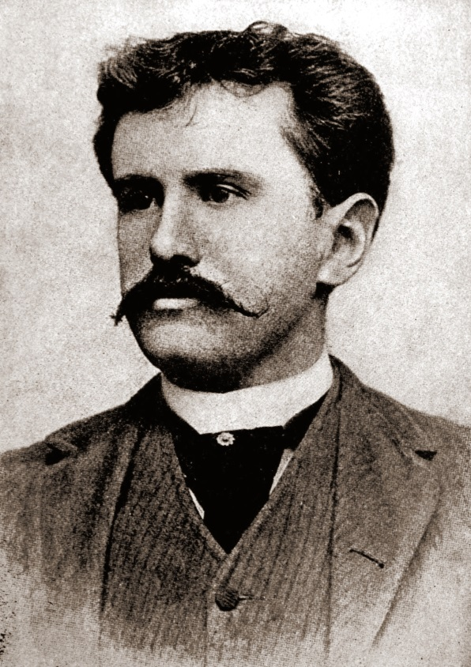
William Sidney Porter
born 11 September, 1862 in Greensboro, North Carolina, to physician Algernon Sidney Porter (1825-1888) and Mary Jane Virginia Swaim (1833-1865)
Had two brothers die in early childhood (Shirley and David)
Will was only three years old when his mother died from Tuberculosis)
Porter spent time in honduras and called it “Banana Republic!
Adapted from : www.online-literature.com/o_henry

Slide 2
Credibility
[kred-uh-bil-i-tee] IPA Syllables
Examples
noun1.the quality of being believable or worthy of trust:After all those lies, his credibility was at a low ebb.
Sometimes, credibleness.
Etymology (the derivation of a word.)
1350-1400; Middle English (< Middle French) < Latin crēdibilis, equivalent tocrēd(ere) to believe + -ibilis -ible

