Slide 1
Timeline of the Sacred Scriptures

Slide 2
Religion Journal Warm-up

Slide 3
How do the events in the Old Testament and the life of ancestors in faith pre-figure Christ’s life?
A life connected to Jesus is a life that loves more, forgives more, and gives more.
“Pre” = Before

Slide 5
The Four Sections of the Old Testament
Law/Pentateuch
“Penta” = Greek for “five”
Genesis, Exodus, Leviticus, Deuteronomy, Numbers
Historical
Ex. Joshua, Judges, 1 & 2 Samuel, 1 & 2 Kings
Wisdom Literature
Psalms (Written by King David)
Proverbs (Written by King Solomon)
Job, Ecclesiastes, Wisdom, Sirach
Prophetic Books
Ex. Isaiah, Jeremiah, Daniel, Jonah, Zechariah

Slide 6
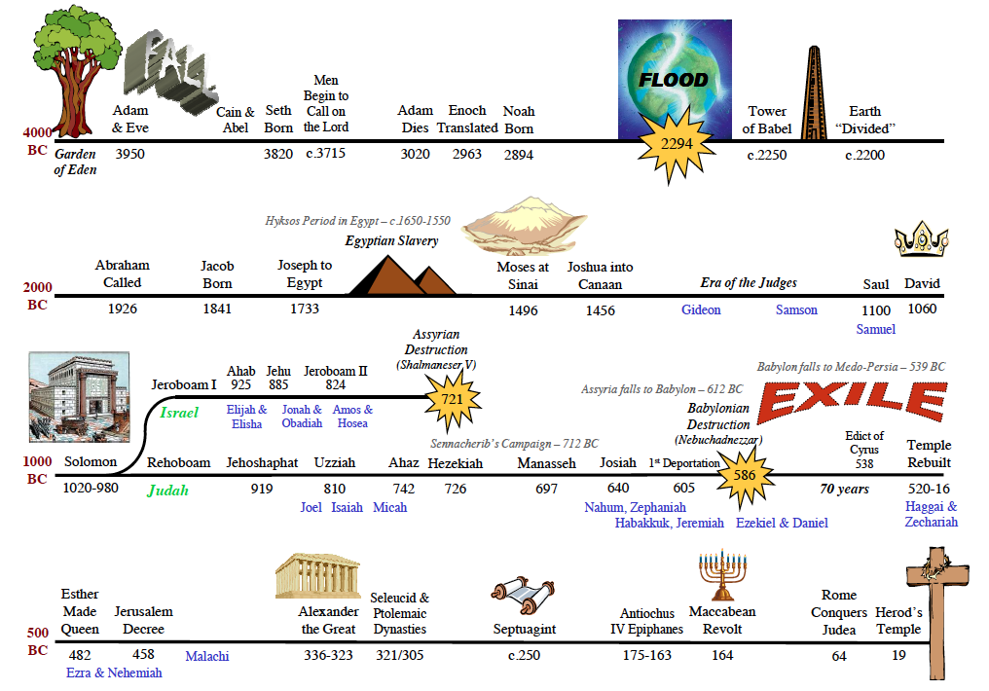

Slide 7
Sacred Scripture Timeline Project
Gospels
0-33 C.E.
“For God so loved the world that he gave his one and only Son that whoever believes in him shall not perish but have eternal life.” John 3:16
My command is this: Love each other as I have loved you. Greater love has no one than this, that he lay down his life for his friends. John 15:12-13
Therefore do not worry about tomorrow, for tomorrow will worry about itself. Each day has enough trouble of its own. Matthew 6:34

Slide 8
Please complete the Socrative Exit Slip
Room Code: SJE678
Teacher Question:
Why are the Sacred Scriptures found in the Old Testament important to us?

